Slide 1
Sociolinguistics
Rizky Lutviana, S.S., S.Pd., M.Pd.

Slide 2
CHAPTER 1
TERMINOLOGIES, FACTORS LANGUAGE CHOICE, & SOCIAL DIMENSION

Slide 3
What is sociolinguistics
The study of language variation caused by social factors
What do sociolinguistics study?
Social function of language
The relationship between language and context in which it is used
Linguistics variation

Slide 4
Sociolinguistics
ELT
Standard pronunciation
Teaching speaking
Speech act
Teaching language components
Language variety
Teaching reading and writing
Code switching
Strategy in teaching
Gender and age factor

Slide 5
Health is a complete state of physical, mental and social well-being, not merely the absence of disease or infirmity
Put your rubbish in the bin, Jilly.
3. Give me the right money and tell me where you’re going.

Slide 6
Variety:
a set of linguistic items with similar distribution, (Hudson, 1996:22)
Example:
Canadian English, London English, the English of football commentaries, and so on.

Slide 7
Variety/code is any set of linguistic forms which patterns according to social factors.
In a broader term variety includes different accents, different linguistic styles, different dialects.

Slide 8
Factors of language usage
Participant
Social setting
Topic
Purpose of interaction

Slide 9
Social dimensions
Social distance
Status
Formality
functional

Slide 10
Social distance scale
Intimate
Distant
High solidarity
Low solidarity

Slide 11
The status scale
Superior
High status
Subordinate
Low status

Slide 12
The formality scale
Formal
High formality
Informal
Low formality

Slide 13
Referential scale
Referential
High information content
Low information content

Slide 14
Affective scale
Affective
Low affective content
High affective content

Slide 15
CHAPTER 2
LANGUAGE CHIOCE IN MULTILINGUAL COMMUNITIES

Slide 16
Variety and Code
Case study
Bukavu, Zaire
Auckland, New Zealand
Paraguay
Portugal
Singapore

Slide 17
Bukavu, Zaire
Multicultural and multilingual city since more people coming are for work and business rather than living for good.
Fourty groups speaking different languages
Language varieties
Shi: formal shi, informal shi,
Swahili: Kingwana, standard Zairean Swahili, Indoubil

Slide 18
Domain | addressee | Setting | Topic | Variety/code
Family | family members | Home | Any topic | Informal shi
Society | Local Vendors | Market |  | Informal shi
Public | Local people | Church, funeral | Wedding Funeral | Formal shi
Tribal Community | People from a different tribal group | Any place | Any topic | Swahili
Education |  | School | Subject | Standard Zairean Swahili
government | Government | Government office | Paying Bill | Standard Zairean Swahili
Community | Younger children, addult, local people | Street, market place | Any topic | Kingwana
Friendship | Young people from all ethnic background | Any place | Any topic | Indoubil

Slide 19
Auckland, New Zealand
Bilingual Tongan
Language varieties: Tongan, English
Domain | Addressee | Setting | Topic | Variety/Code
Family | Parent | Home | Planning a family party | Tongan
Friendship | Friend | Beach | How to play beach tennis | Tongan
Religion | Priest | Church | Choosing the Sunday liturgy | English
Education | Teacher | School | Solving a math problems | English
Employment | Employer | Workplace | Applying for a promotion | English

Slide 20
Paraguay
Language varieties : Spanish, Guarani
Spanish, the language of the colonisers, spoken by people who live in cities
Guarani, the tribal language of American Indian, spoken by local people
Domain of language use, see Holmes p. 22.

Slide 21
Portuguese
Immigrant people living in another country
Language varieties: Portuguese and English
Portuguese : home and church
English : school and workplace

Slide 22
Singapore
Domain | Addressee | Setting | Variety/Code
Family | Family members | Home | Cantonese
Friendship | Friends |  | Singapore English
 |  | Small shop Market place | Hokkien
 |  | Larger department store | Singapore English
Education Mass media |  | Primary school | Mandarin Chinese
Governmetal matter |  | Government office | Formal Singapore English
Education |  | University | English

Slide 23
Factors influence code choice
Social
Charateristics of participant
Purpose
Topic
Social distance
Status
Social role
Setting
Formality
Function

Slide 24
Assignment
Answer these question individually, and then share the answer with your pair.
How many languages do you speak?
Explain how do you use it by completing this chart
Domain | Addressee | Setting | Variety/Code

Slide 25
CHAPTER 3
CODES

Slide 26
What is code?
Code can be used to refer to any kind of system that two or more people employ for communication.

Slide 27
Lingua franca
A language which is used habitually by people whose mother tongues are different in order to facilitate communication between them. (UNESCO, 1953)

Slide 28
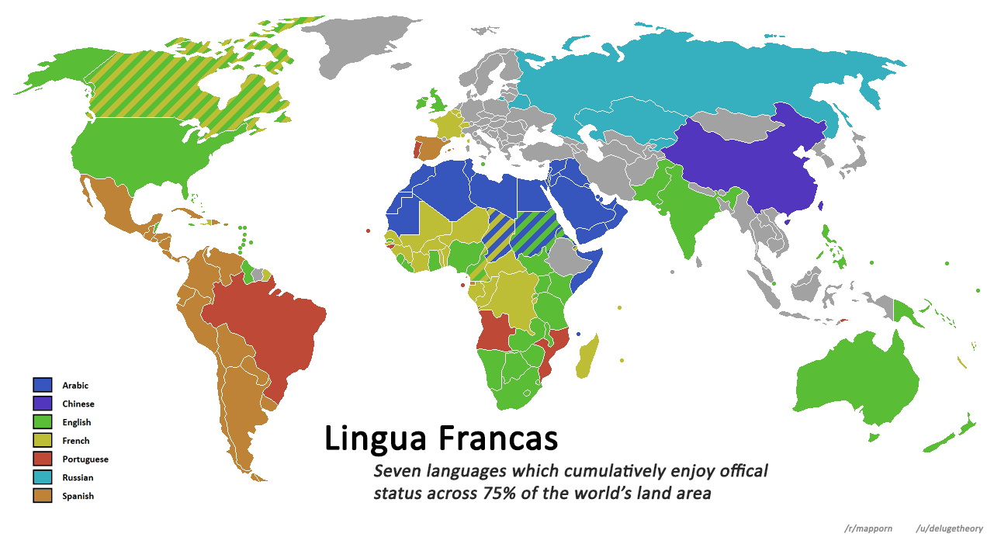

Slide 29
1. English – is a language uses to travel and often in trade, commerce, and international relations
2. Michif – Lingua franca in Canada (Cree and French) to express identity
3. Mandarin- Lingua franca of Chinese who live in different countries
4. Swahili - is a lingua franca of East Africa

Slide 30
Pidgin and Creole
A pidgin is a language with no native speakers: it is no one’s first language but is a contact language. (Wardhaugh, 2006:61)
product of a multilingual situation in which those who wish to communicate must find or improvise a simple language system that will enable them to do so.
that situation is one in which there is an imbalance of power among the languages as the speakers of one language dominate the speakers of the other languages economically and socially.

Slide 31
a creole is often defined as a pidgin that has become the first language of a new generation of speakers.

Slide 32
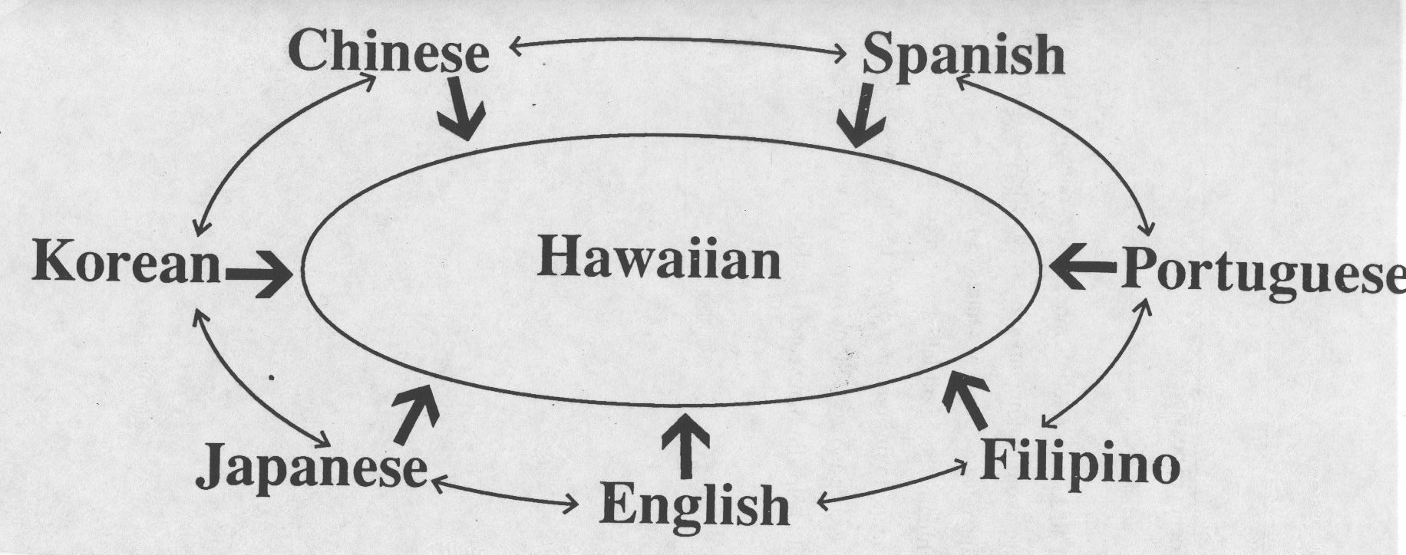
Creole

Slide 33
German
Malay
Purtuguese
Austronesian
Tok Pisin

Slide 34
Diglossia
Wardhaugh (2006:89)
A diglossic situation exists in a society when it has two distinct codes which show clear functional separation; that is, one code is employed in one set of circumstances and the other in an entirely different set.

Slide 35
Holmes (p. 27)
Diglossia has three features:
Two distinct varieties of the same language are used in the community, with one regarded as a high (H) variety and the other a low (L) variety
Each variety is used for quite distinct function, H and L complement each other.
No one uses the H variety in everyday conversation.

Slide 36
The term diglossia describes societal or institutionalized bilingualism, where two varieties are required to cover all community’s domain. (Holmes, p. 30)

Slide 37
Polyglossia
Situations where more than two distinct codes or varieties are used for clearly distinct purposes or in clearly distinguishable situations.

Slide 38
Which country(ies) is/are diglossic?
Bukavu, Zaire
Auckland, New Zealand
Paraguay
Portugal
Singapore

Slide 39
Compare between two English varieties
Formal English “Speech”
“Losing my future is not like losing an election or a few points on the stock market. I am here to speak for all generations to come.” “I am here to speak on behalf of the starving children around the world whose cries go unheard.”

Slide 40
CHAPTER 4
CODE SWITCHING

Slide 41
rasa hati ini uwes broken nemu kamu wes tak sobek sobek kang mas indehoy karo miss tukinem don’t alesan don’t many alesan i sudah know mas you bajingan suka jajan your wife ini minta di ceraikan sirahku saiki uwes puyeng gara gara i think macem macem ora peduli how do you how how iing penting jupe uwes seneng it’s oke wae mas it’s oke wae aku rapopo..aku rapopo..aku rapopo don’t comeback again mas don’t comeback again aku rapopo..aku rapopo..aku rapopo mas aku nyambut gawe, gae kowe ayuku gawe kowe, awakku gawe kowe tapi, kenopo, kenopo, kenopo

Slide 42
Multilingual communities
Two or more languages are used in daily communication
Situations
Code switching
Contexts
Purposes

Slide 43
What is code-switching
the alternate use of two or more languages or varieties of language, especially within the same discourse. (www.dictionary.com)

Slide 44
Wardaugh (2006:101)
Code-switching (also called code-mixing) can occur in conversation between speakers’ turns or within a single speaker’s turn. In the latter case it can occur between sentences (intersententially) or within a single sentence (intra-sententially).

Slide 45
As Gal (1988, p. 247) says, ‘codeswitching is a conversational strategy used to establish, cross or destroy group boundaries; to create, evoke or change interpersonal relations with their rights and obligations.’

Slide 46
Participant → solidarity
Domain, the arrival of a new person to express solidarity
Sarah : I think everyone’s here except Mere.
John : She said she might be a bit late but actually I think that’s her arriving now.
Sarah : you’re right. Kia ora mere. Haere mai. Kei te pehea koe? (HI MERE. COME IN HOW ARE YOU?)
Mere : Kia ora e hoa. Kie te pai. Have you started yet? (HELLO MY FRIEND. I’M FINE.

Slide 47
Social → Signal of group membership
Tag switching to express ethnic identity marker
Chat, discussing movie
X : Eh, ada film bagus.
Y : Apa?
X : Film india judulnya PK. Alien tersesat di bumi, punya remot buat pulang tapi hilang dicuri...
Y : wah, lucu kayaknya, series yo?
X : ora.. Film... trus critanya kan dia neliti siapa yg bisa bantu nemuin remot . Jawaban terbanyak dsuruh minta tolong ke tuhan . Lah, iku wis ....apik. Dia melajarin semua agama...

Slide 48
Purpose
Code switching can be used to get certain purpose
Jan : Hello Petter. How is your wife now?
Petter : oh, she’s much better thank you Jan. She’s out of hospital and convalescing well.
Jan : That’s good I’m pleased to hear it. DO YOU THINK YOU COULD HELP ME WITH THIS PESKY FORM? I AM HAVING A GREAT DEAL OF DIFFICULTY WITH IT.
Petter : OF COURSE. GIVE IT HERE...

Slide 49
Topic
People may switch code within a speech event to discuss a particular topic billinguals often find it easier to discuss particular topics in one code rather than another.
For instance, Chinese students flatting together in English-speaking countries tend to use Cantonese with each other

Slide 50
Code switching/mixing to quote a proverb or a well-known saying in another language
A group of Chinese students are discussing Chinese customs.
Li : People here get divorced too easily. Like exchanging faulty goods. In China it’s not the same. Jia gou sui gou, jia ji sui ji. (IF YOU HAVE MARRIED A DOG, YOU FOLLOW A DOG, IF YOU’VE MARRIED A CHICKEN, YOU FOLLOW A CHICKEN)

Slide 51
Switching for affective functions
H
L
Joke /Rude remark
L
H
Express disapproval

Slide 52
In the town of Oberwart two little Hungarian-speaking children were playing in the woodshed and knoecked over a carefully stacked pile of firewood. Their grandfather walked in and said in Hungarian, the language he usually used to them:
‘szo! Ide dzuni! Jeszt jeramunyi mind e kettuotok, no hat akkor!’
(WELL COME HERE! PUT ALL THIS WAY, BOTH OF YOU, WELL NOW.)
When they did not respond quickly enough he switched to German:
‘Kum her!’
(COME HERE)
Father :Tea’s ready Robbie.
(Robbie ignores him and carries on skate-boarding.)
Father : Mr. Robert Harris if you do not come in immediately there will be consequences which you will regret.

Slide 53
Metaphorical switching
To show membership of a community as well as to persuade people
Ambivalent feelings:
One language to express refferential content and another to express shame and embarrassment

Slide 54
CHAPTER 5
SPEECH COMMUNITIES

Slide 55
Various Definitions of speech communities
Chomsky
Lyons
Giles, at al.
Labov
Gumperz
Hymes

Slide 56
1. Chomsky (1965, pp. 3–4)
‘completely homogeneous speech community’
→ This is narrow definition of speech community
2. Lyons (1970, p. 326), ‘real’ speech community:
‘all the people who use a given language (or dialect).’

Slide 57
Giles, Scherer, and Taylor (1979, p. 351); speech markers,
through speech markers functionally important social categorizations are discriminated, and . . . these have important implications for social organization. For humans, speech markers have clear parallels . . . it is evident that social categories of age, sex, ethnicity, social class, and situation can be clearly marked on the basis of speech, and that such categorization is fundamental to social organization even though many of the categories are also easily discriminated on other bases.

Slide 58
Labov, (1972, pp. 120–1):
The speech community is not defined by any marked agreement in the use of language elements, so much as by participation in a set of shared norms; these norms may be observed in overt types of evaluative behavior, and by the uniformity of abstract patterns of variation which are invariant in respect to particular levels of usage.

Slide 59
Gumperz (p. 101) to use the term linguistic community rather than speech community.
a social group which may be either monolingual or multilingual, held together by frequency of social interaction patterns and set off from the surrounding areas by weaknesses in the lines of communication. Linguistic communities may consist of small groups bound together by face-to-face contact or may cover large regions, depending on the level of abstraction we wish to achieve.

Slide 60
In this definition, then, communities are defined partially through their relationships with other communities. Internally, a community must have a certain social cohesiveness; externally, its members must find themselves cut off from other communities in certain ways.
The factors that bring about cohesion and differentiation will vary considerably from occasion to occasion.

Slide 61
Hymes (p. 51)
‘a local unit, characterized for its members by common locality and primary interaction.’
Hymes also distinguishes (pp. 50–1) between participating in a speech community and being a fully fledged member of that community:

Slide 62
To participate in a speech community is not quite the same as to be a member of it. Just the matter of accent may erect a barrier between participation and membership in one case, although be ignored in another. Obviously membership in a community depends upon criteria which in the given case may not even saliently involve language and speaking, as when birthright is considered indelible.

Slide 63
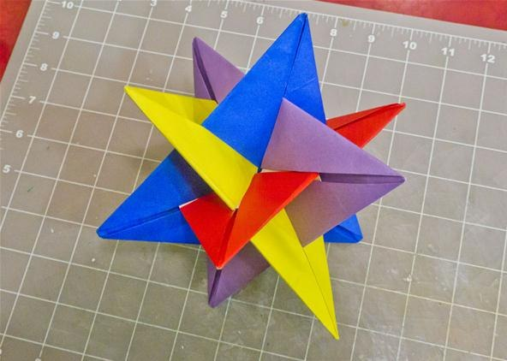
Intersecting community
a person may belong at any one time to many different groups depending on the particular ends in view.

Slide 64
Is there any limit?
The concept must be flexible because individuals find it advantageous to shift their identities quite freely. As Bolinger (1975, p. 333) says, There is no limit to the ways in which human beings league themselves together for self-identification, security, gain, amusement, worship, or any of the other purposes that are held in common; consequently there is no limit to the number and variety of speech communities that are to be found in a society.

Slide 65
What is the reason?
Saville-Troike (1996, p. 357) ‘Individuals may belong to several speech communities (which may be discrete or overlapping), just as they may participate in a variety of social settings. Which one or ones individuals orient themselves to at any given moment – which set of social and communicative rules they use – is part of the strategy of communication.

Slide 66
What factors influence?
The group chosen to identify with will change according to situation: at one moment religion may be important; at another, regional origin; and at still another, perhaps membership in a particular profession or social class. An individual may also attempt to bond with others because all possess a set of characteristics, or even just a single characteristic, e.g., be of the same gender, or even because all lack a certain characteristic, e.g., not be of white skin color

Slide 67
One of the consequences of the intersecting identifications is, of course, linguistic variation: people do not speak alike, nor does any individual always speak in the same way on every occasion.

Slide 68
Network and repertoire
‘A network
You are said to be involved in a dense network if the people you know and interact with also know and interact with one another. If they do not the network is a loose one.
multiplex network if the people within it are tied together in more than one way

Slide 69
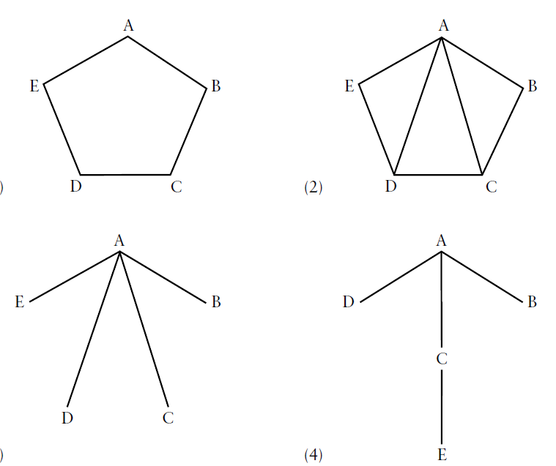

Slide 70
A speech repertoire
is the range of linguistic varieties which the speaker has at his disposal and which he may appropriately use as a member of his speech community.’
The concept of ‘speech repertoire’ may be most useful when applied to individuals rather than to groups.

Slide 71
We . . . suggest the term speech repertoire for the repertoire of linguistic varieties utilized by a speech community which its speakers, as members of the community, may appropriately use, and the term verbal repertoire for the linguistic varieties which are at a particular speaker’s disposal.

Slide 72
Read this case of speech community and then answer the questions.
a small group of Indonesian graduate students and their families living in the United States. Among them these students knew nine different languages, with nearly everyone knowing Indonesian (Bahasa Indonesia), Javanese, Dutch, and English. They tended to discuss their academic work in English but used Indonesian for most other common activities. Unlike Javanese, ‘Indonesian . . . , whether the official or the daily variety, is regarded as a neutral, democratic language. A speaker of Indonesian need not commit himself to any particular social identity, nor need he impute one to those with whom he converses’ (p. 134). The students also used Dutch, but mainly as a resource, e.g., for vocabulary, or because of the place it necessarily held in certain fields of study, e.g., Indonesian studies. Local languages like Javanese tended to be used only with intimates when fine shades of respect or distance were necessary, particularly when in the presence of important older people.

Slide 73
Questions
1. who is/are the subject(s)?
2. How many languages are there? Mention?
3. Give the information of language domain!
4. What are the factors of language use?
5. Draw a network, if you is A, B is your parents, C is your close friend who speak the same tribal language, D is your collage friend who is the native speaker of English.
6. As a member of Indonesian speech community, what is your repertoire of linguistics? What is your verbal repertoire?
7. As a member of English speech community, what is your repertoire of linguistics? What is your verbal repertoire?

