Slide 1
The Use of Media in English Language Teaching and Learning By Teguh Sulistyo
Micro Teaching

Slide 2
Choosing appropriate media is really a great challenge for English teachers.

Slide 3
Good Media
inspire teachers and engage students.
stimulate students to actively join the English language teaching and learning.
develop students’ curiosity to learn more and more

Slide 4
Kinds of Media
1. Visual : can be seen only
2. Audio : Can be heard only
3. Audio-Visual: can bee seen and heard

Slide 5
Kinds of Media
1. Visual : can be seen only
- pictures, charts, graphics, bulletins, magazines,
Silent films (soundless videos), maps, posters

Slide 6
Kinds of Media
2. Audio : can be heard only
Ex.- songs, tapes, sounds of animals, music instrument, etc.

Slide 7
Kinds of Media
3. Audio-Video : can be heard and seen Ex. Videos, films, broadcasting news

Slide 8
1)What is it? 2) What is it for?

Slide 9
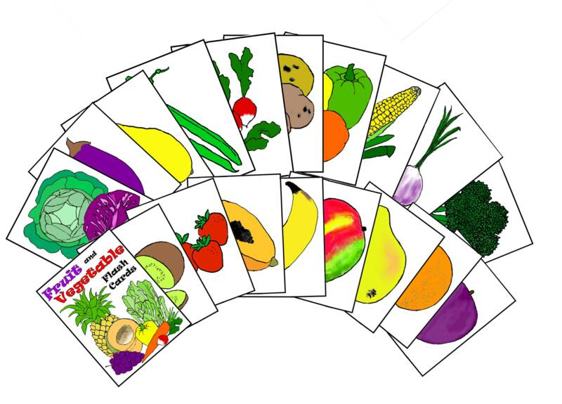
1)What is it? 2) What is it for?

Slide 10
1)What is it? 2) What is it for?

Slide 11
1)What is it? 2) What is it for?

Slide 12
What kinds of teachers are you?
1. The mediocre teacher tells
2. The good teacher explains
3. The superior teacher demonstrates
4. The great teacher inspires.
By: William A. Ward

Slide 13
Thanks
Good Luck
Your future is waiting for you.

